Slide 1
Digital Humanities Pedagogy
Crystal Hall
chall@bowdoin.edu

Slide 2
Definitions of Digital Humanities:
Using digital tools to ask humanistic questions
Asking humanistic questions about digital tools, methods, practices, objects
Using humanistic priorities and methods to shape the development of digital tools, methods, practices, objects

Slide 3
DH Variety A: ENGL 2305: Imagining London in Eighteenth-Century Literature
Prof. Ann Kibbie, Bowdoin College with Library Support Staff
18 students, in laptop lab

Slide 4
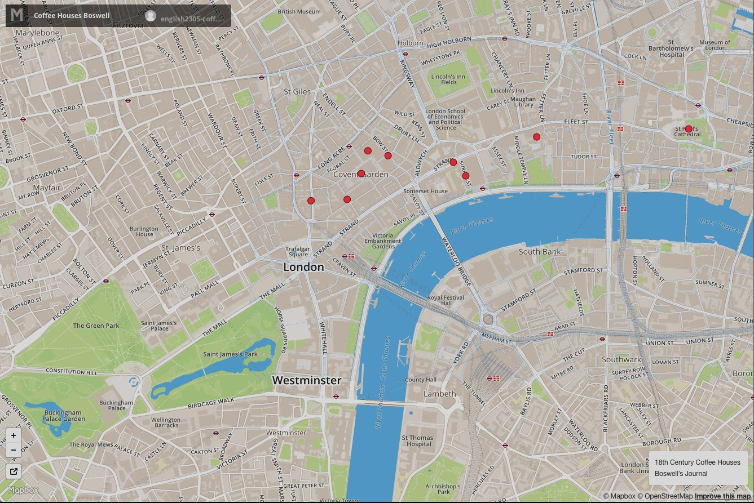
Boswell’s Coffee Houses

Slide 5
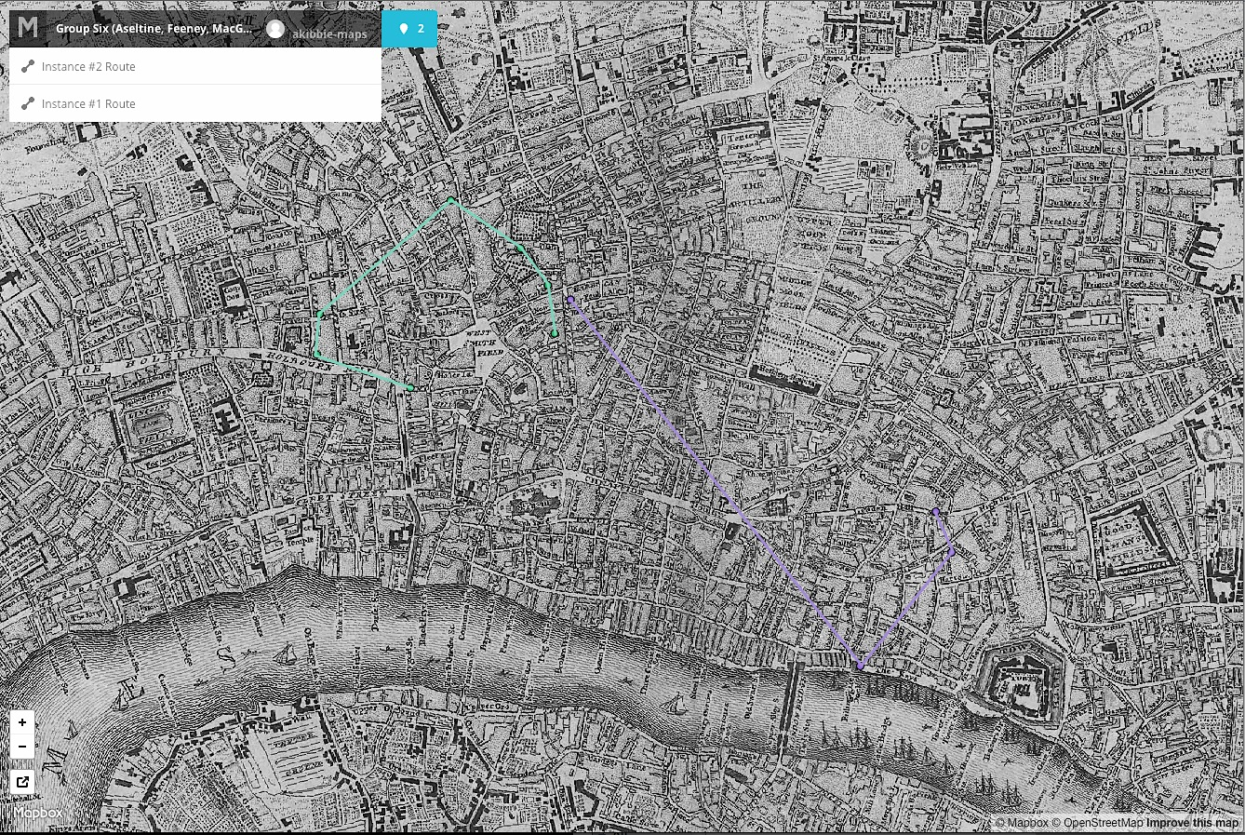
Moll’s Escape Routes

Slide 6
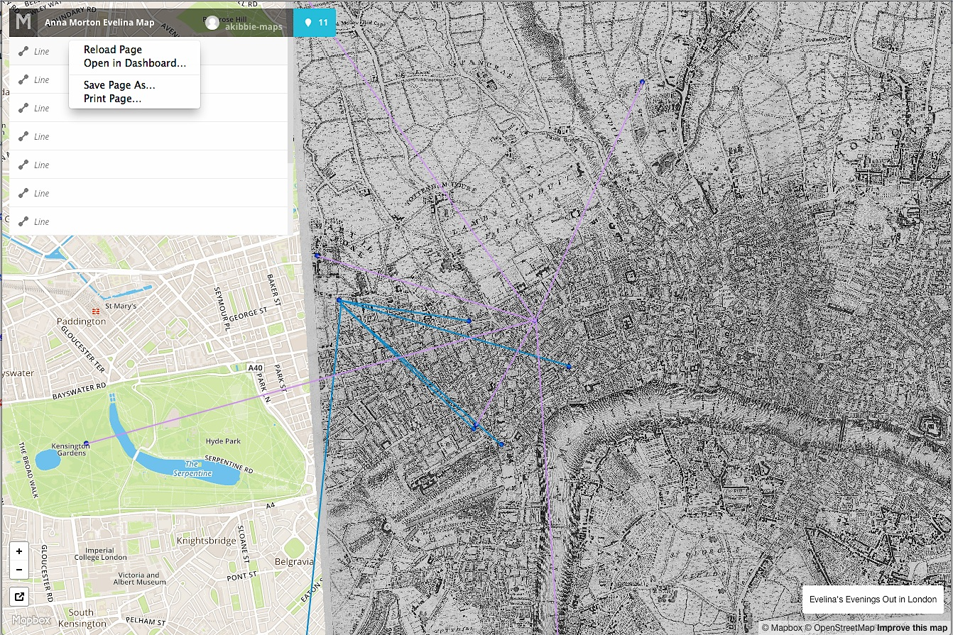
Anna Morton Evelina Map

Slide 7
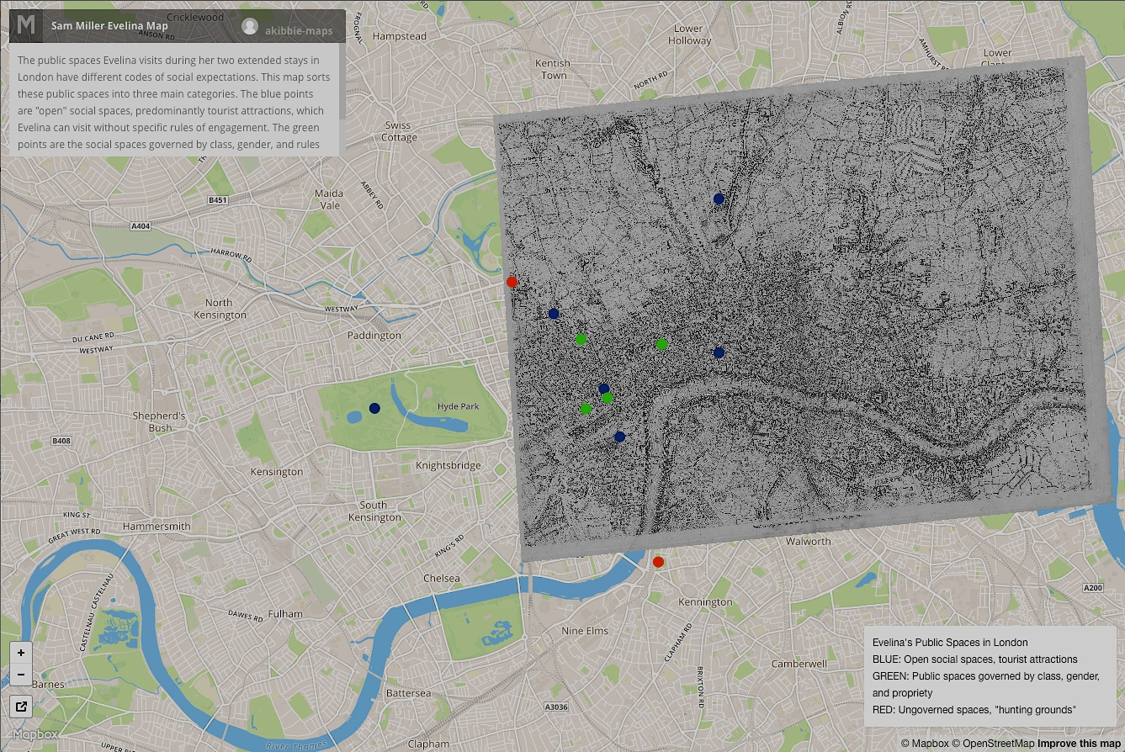
Samuel Miller Evelina Map

Slide 8
Question:
Could juxtaposition be a useful tool in your pedagogical design?
The original (material) vs. the digital
Several examples of the digital
Different categories of the content

Slide 9
DH Variety B: DCS 1100: Introduction to Digital and Computational Studies
Two of the following in a given semester:
Profs. Crystal Hall (DH, Italian), Mohammad Irfan (CS, DCS), Erin Johnson (Visual Arts, DCS), Fernando Nascimento (DCS, Philosophy) with Academic Technology Support Staff
35 students, laptop lab

Slide 10
What?
What’s our application? And what tools are we using or developing?
Creative expression
Database development and analysis
Hardware
Image analysis
Modeling
Network analysis
Software
Spatial analysis
Textual analysis
?

Slide 11
How?
How does it work? Let’s look ‘under the hood’.
How much time?
How in depth?
How hands-on?
Design
Data set(s)
Visualization
Analysis

Slide 12
Why?
Why do we develop and use these tools? And why do they work the way that they do? Let’s put them in context.
problem solving
creative expression
social, political, and economical implications of using a tool
psychological implications of data use, tool use, etc.
investigating new kinds of knowledge
identifying historical implications
evaluating ethical implications
exploring social practices digital or computational tools allow
?

Slide 13
Question:
What questions in your field can be applied to the digital tools, methods, or objects that you are considering adopting for the unit or course you proposed?

Slide 14
DH Variety C: FILM 1101: Film Narrative
Prof. Allison Cooper (Film, Italian), Bowdoin College with Information Technology and Academic Technology Support Staff
50 students, lecture hall and media lab (outside of class meetings)

Slide 15
Kinolab (The Bowdoin Digital Clip Archive)
Custom Omeka template designed by Andrew Currier, Bowdoin IT

Slide 16
Student Projects, Phase One filmography

Slide 17
Student Projects, Phase Two clip selection
Clips compiled, annotated, and tagged by Jillian Burk, Alex Roche, Christy Jewett, Liz Rill, Leaf Ma, and Katie Gately

Slide 18
Student Projects, Phase Three clip detail

Slide 19
Student Projects, Phase Three tag detail

Slide 20
Questions:
Do you want students from future iterations of the course to contribute to the digital project that you are starting?
What does “finished” mean for your students’ work? For your project?

Slide 21
(False) Dichotomies
Following Fitzpatrick:
Theory vs. practice
Interpretation vs. construction
Critical thinking vs. skill development
Question:
Would you be satisfied if students were to focus on the process of building, evaluate a prototype, make a contribution to a product, or work with a final product? That is, at what stage of a DH project do you see the most appropriate fusion of the terms in the dichotomies?

Slide 22
Differences from non-DH courses:
Tools for Study
Outward-facing (publics)
Objects of Study
Interactivity
Collaboration
Inclusivity

Slide 23
Objects of Study
“But where is the text in what you do?” – from a member of the hiring committee for my job at Bowdoin

Slide 24
DCS 1020: How to Read 1,000,000 Books
First Year Seminar
no lab component
held in 304 Visual Arts Center (laptop lab)
10 students (first iteration)
The question: how is meaning made through books (as objects, through their contents, by readers) at increasing scales of analysis?

Slide 25
What does a computer see? What do we see?
love
Love
love?
love!
love:

Slide 26
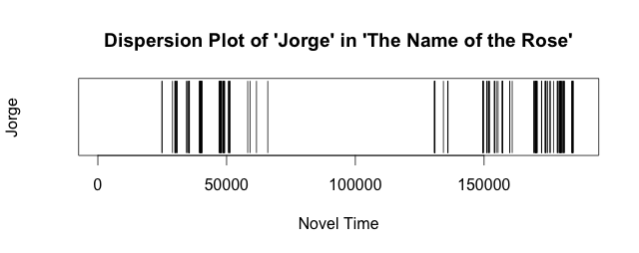
One Book vs. One Hundred
Plot Fingerprints

Slide 27
Interactivity
Is not data entry.
Is an opportunity to learn from others, from the object of study, from the process of using a tool, from communicating an interpretation.

Slide 28
Samuel Miller Evelina Map

Slide 29
Collaboration
Is not based on technical aptitude (use of an application, ability to write the report, managerial skills).
Is a chance for all perspectives on the learning goal to be heard.

Slide 30
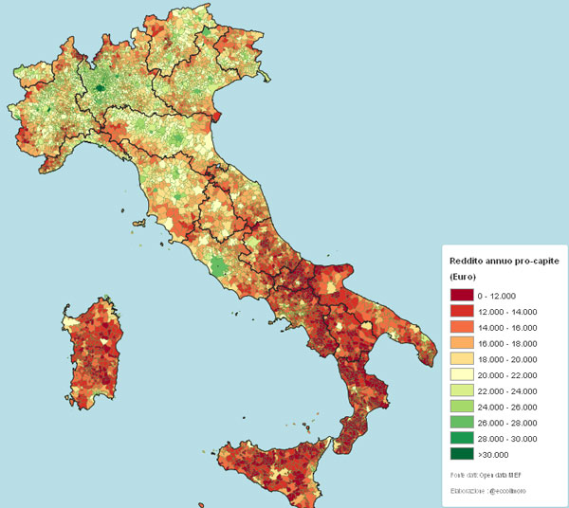
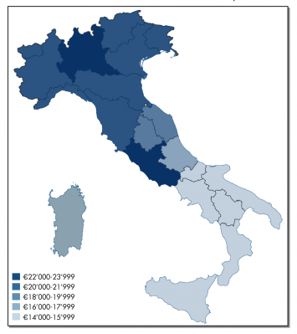
Inclusivity
Nicolas Lazito, “Reddito Italiano Medio – Regione per Regione”
http://www.comeinvestireoggi.com/in-primo-piano/12305/redditi-degli-italiani-per-comune/

Slide 31
Part Two: Examples of Syllabi

Slide 32
Part Three: A Case Study
Joshua Chamberlain at the Battle of Little Round Top

Slide 33
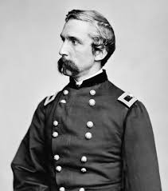
The Case Study: JLC@LRT
Bowdoin Class of 1852
Teacher at Theological Seminary in Bangor, ME
Professor of Rhetoric, Oratory, & Modern Languages @ Bowdoin
Army of the Potomac – 4 years
Lieutenant Colonel → General
Wounded 6 times 2 (or 1?) near-fatal
Governor of Maine - 4 terms
President of Bowdoin
Commissioner of Education to Paris World’s Expo
President of a Railroad Company
Surveyor of Customs for Port of Portland
Joshua Lawrence Chamberlain
1828-1914

Slide 34
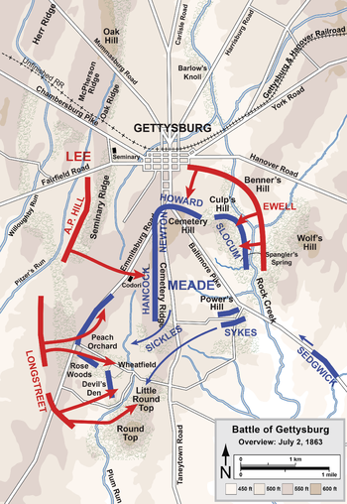
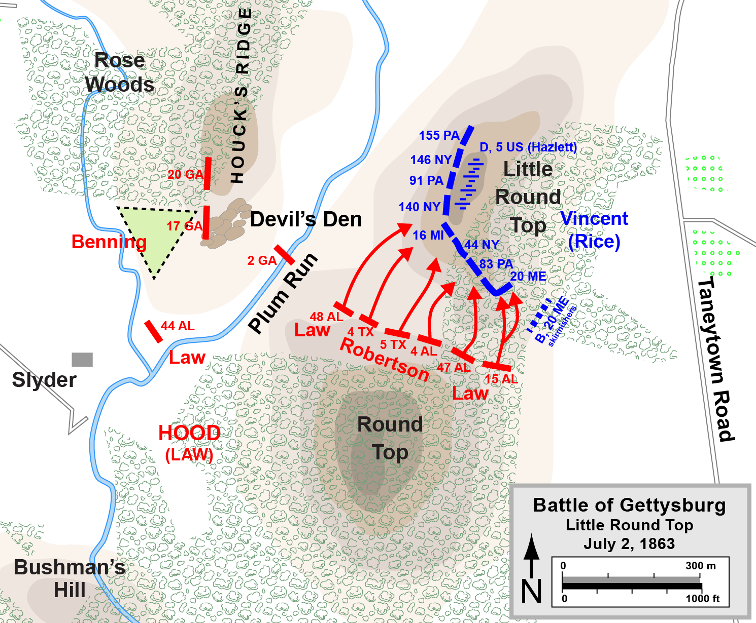
Little Round Top

Slide 35
A Project in Three Parts:
Transcribing and encoding a primary document using XML (pairs)
Aligning a historical map with modern spatial representations using ArcGIS (individual)
Creating a 3D representation of the historical site and selecting a vantage point from which to calculate JLC’s visibility using ArcGIS (individual, with requirement to explore other visualizations made by classmates)
Assignment descriptions are available on the Git site for this workshop.

Slide 36
Your turn! (for my students, not this workshop)
Draw a map (by hand) based on the information in the document assigned to you. Work independently.
Work with a partner to talk through the decisions and assumptions that you made in order to determine where to draw the vectors (points, lines, and polygons) that you inferred from the details in the paragraph or presentation.

Slide 37
Questions to ask about your document:
Why did the author prepare the document? How might this reflect its goals?
What strategy is used to achieve those goals?
What values are expressed in the document? What values do I bring to the document as a reader?
What can I know about the past based on this document?
How does this document compare and contrast with others like it?
Adapted from Prof. Patrick Rael

Slide 38
Handling ambiguity and multiple “truths”: Our assets for the project
Volume
Variety
Velocity
Veracity
Value
Asynchronicity
Collaboration/Crowd sourcing
Decentralization
Discrete Choices
Models of Reality
Credibility
Verification
Corroboration
Reliability
Tone

Slide 39
More reasons to bother:
Learning about the cultural conventions of communication
Learning about how mythmaking and memorializing occur in a given context
We recount the past constantly through visuals – can we learn something about ourselves?
Resisting a linear narrative by creating an immersive recreation

Slide 40
Implications for the geoprocessing assignment:
In a digital map or spatial analysis where is space for ambiguity, multiple perspectives, considering power structures, marginalized voices, contextualization, or missing information?
Should we all place Chamberlain in the same spot? Should we all place Chamberlain?

Slide 41
XML Assignment Excerpt
“Encoding is absolutely an act of interpretation. Choosing where and how to place tags completely defines what the data derived from the items to be encoded looks like. Anything that involves “coding” or “data” can easily be viewed as objective, but it is important to remember that the parameters of this data is defined somewhat subjectively. Encoding is transforming data from one form to another, and the methods used in that transformation can only be called interpretation.” Julian Andrews, Fall 2016

Slide 42
Georeferencing Assignment
“Additionally, based on this exercise, one could mistakenly interpret that the digital maps are correct and the historical ones are not. I am hesitant to completely accept the validity of current digital maps, because just as map production and technology has improved since 1875 and 1904 (the years of the maps I examined), it is possible that digital maps still have more to improve on for the future.” Ashley Koatz, Fall 2016

Slide 43
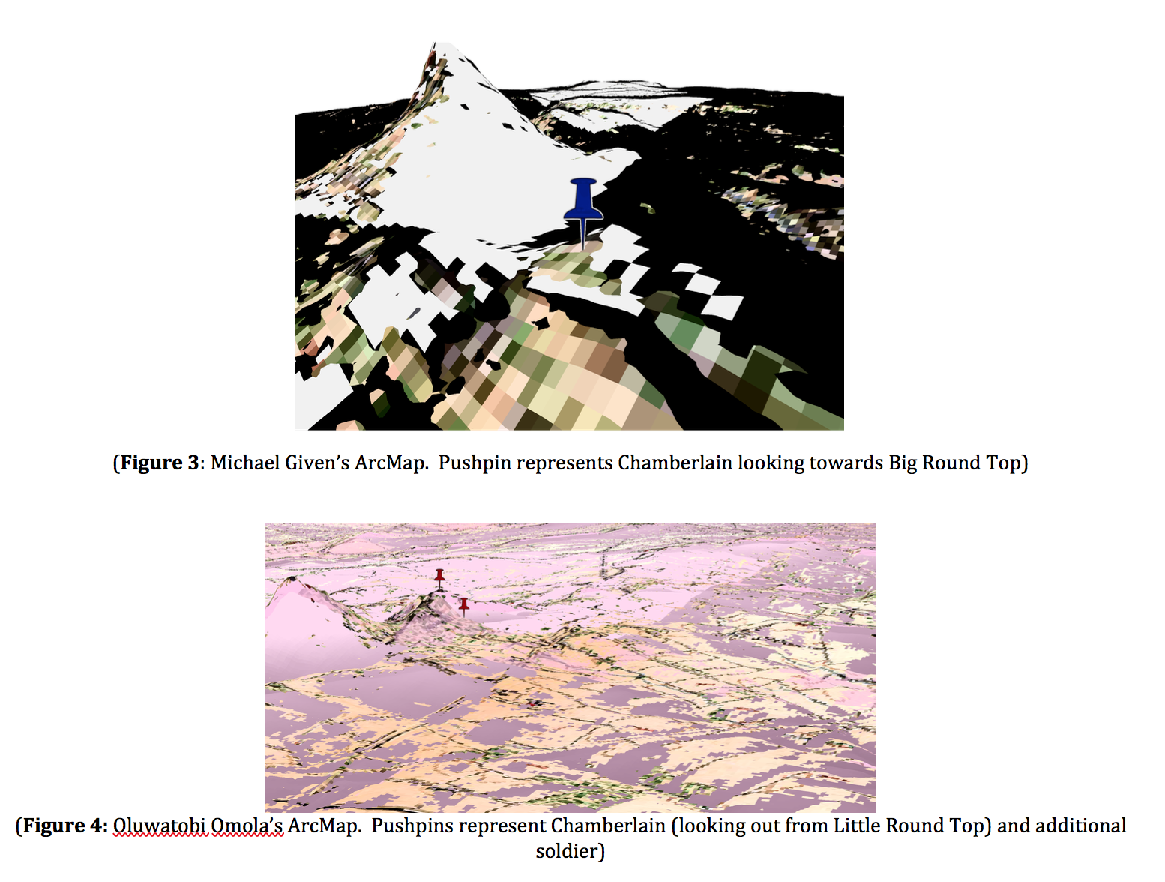
Geoprocessing Assignment
Though I remarked in a previous reflection that topographical models only represented a single space in time and not a dynamic battle, this problem could be mitigated through collaboration. If we were to line up all of our models in parallel with primary resources, we could potentially create a visual “timeline” of Chamberlain’s movements.
-McKenna Thomas-Franz, Fall 2016

Slide 44
Your Turn: (for this workshop, not my students)
Using the examples of assignments as prompts for how (not) to communicate goals to students, can you make a preliminary outline the assignment, big picture, and evaluation steps for the unit or course that you are developing?
Can you identify where you will need assistance in connecting those pedagogical “dots”?
Be ready to share with a partner for feedback.

